Slide 1
AI and the Library World
an Online with the CMC webinar
Eric McKinney
Cataloger
Cataloging Maintenance Center
Anslie Waldrep
Intern
Cataloging Maintenance Center
April 11, 2024

Slide 2
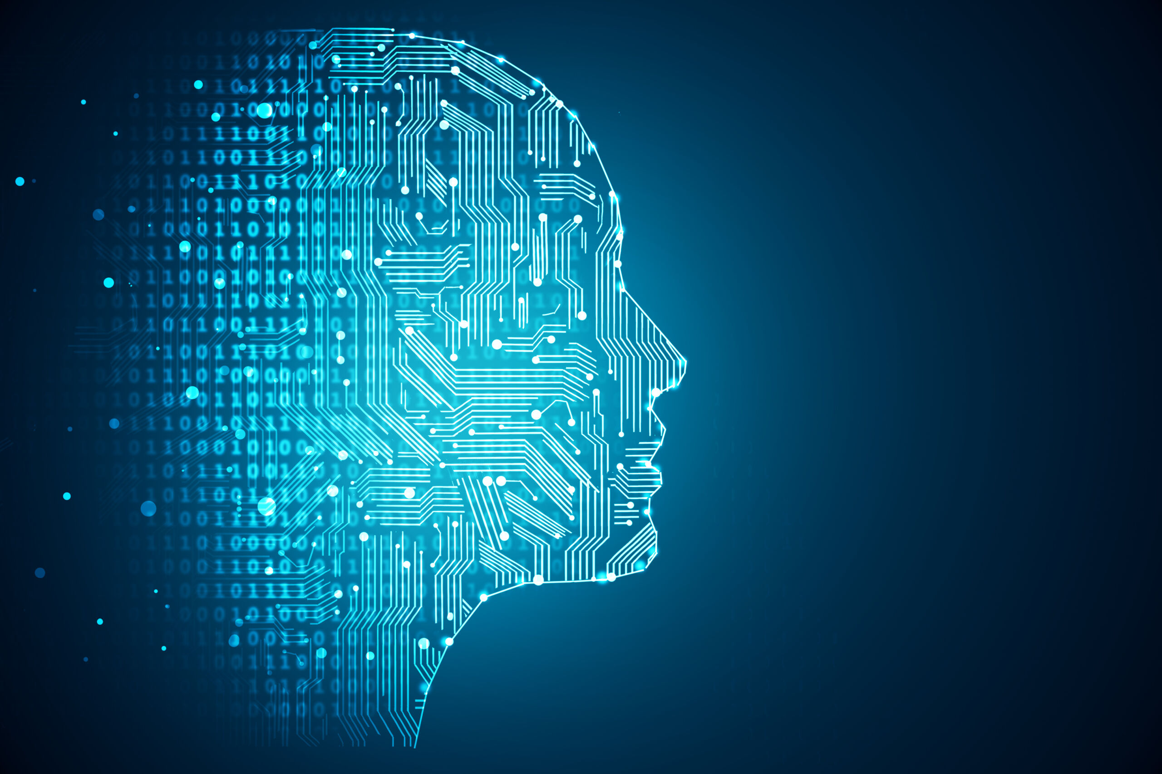
Agenda
Bios
What is AI?
What Can AI Do?
Challenges with implementing AI
Demo Time

Slide 3
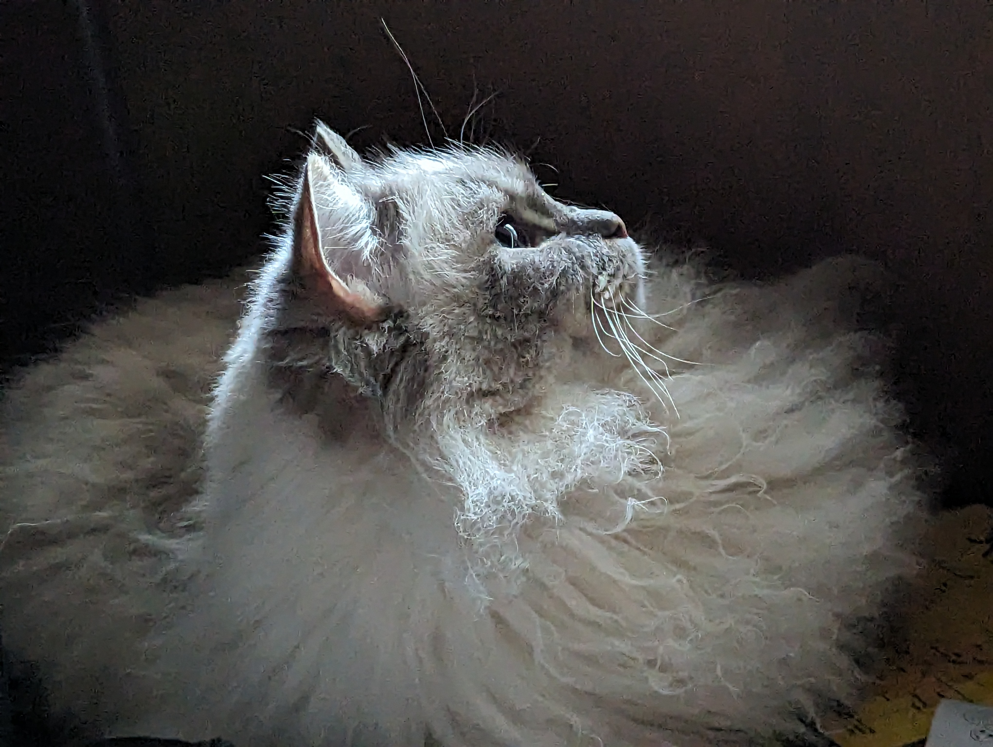
Eric McKinney
15+ years of cataloging experience
Married to a librarian
Enjoys spending time with friends, family and pets
Likes tacos
Tyrion
Griffin

Slide 4
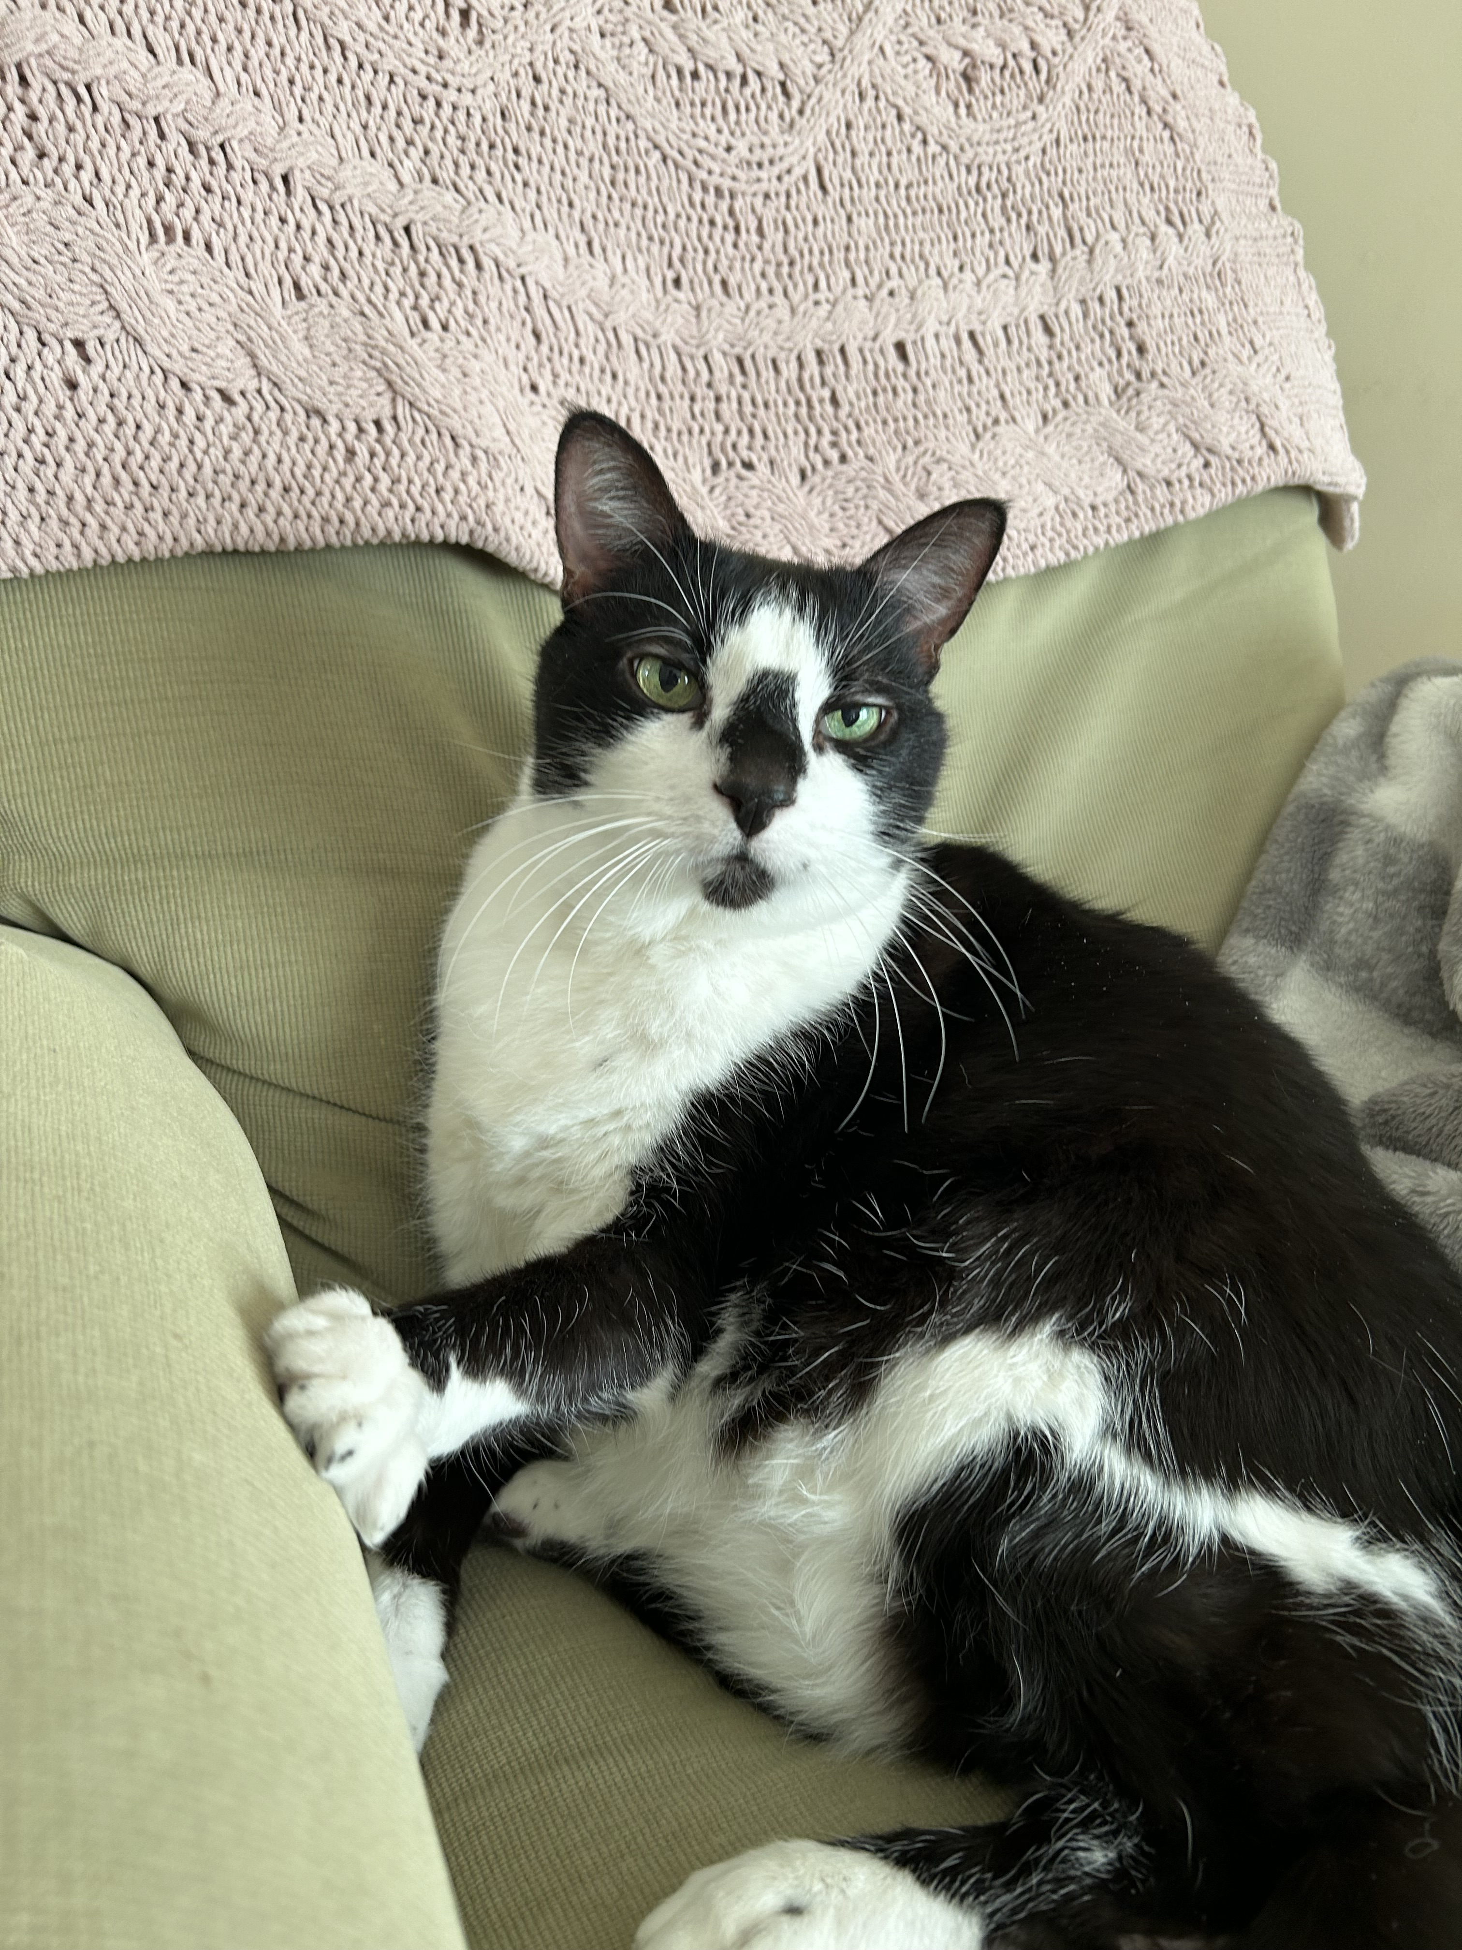
Anslie Waldrep
One of the CMC Interns this spring semester
Currently pursuing my Master's Degree in Library and Information Science at the University of Iowa
Also work at The Urbana Free Library as a Patron Services Specialist
In my free time, I enjoy reading, puzzles and hanging out with my cats

Slide 5
What is AI?
AI = Artificial Intelligence
Open AI's definition - "highly autonomous systems that outperform humans at most economically valuable work"
Examples of free AI (AI that the public has access to)
ChatGPT – November 2022
BingAI – February 2023
Bard/Gemini - March 2023
Biggest question with AI
How to evaluate the information coming from these sources?
ChatGPT 3.5

Slide 6
What Can AI Do?
Chat
Image
Video

Slide 7
Challenges with implementing AI
Technological Constraints
Smaller libraries might not have the resources to maintain AI
Need to have a level of digital literacy to understand how to access but also use the AI technology
Rapid pace of technology change
Since AI is constantly changing, libraries will have to update their systems and learn the new developments
Ethical and privacy concerns
AI relies on data to function – this data could consist of patron data that is sensitive
Reader's advisory from AI – accessing their reading history
How can we protect data while also having access to a service that can be beneficial to our library?

Slide 8
Challenges with implementing AI
Bias
Can come about from the data that is used to train the AI or from the person who made the AI (algorithmic bias)
Reader's Advisory – how will the recommendations be fair and unbiased
Not 100% perfect
AI is not perfect

Slide 9
Live demo
Querying
Call numbers
Subject headings
Library promotion
Bib Records

Slide 10
Querying
“Generative AI has the potential to change the world in ways that we can’t even imagine. It has the power to create new ideas, products, and services that will make our lives easier, more productive, and more creative. It also has the potential to solve some of the world’s biggest problems, such as climate change, poverty, and disease.” Bill Gates
An AI is only as useful as the query

Slide 11
Call numbers
Library of Congress
DDC 23
“The new spring in AI is the most significant development in computing in my lifetime. Every month, there are stunning new applications and transformative new techniques. But such powerful tools also bring with them new questions and responsibilities.” Sergey Brin

Slide 12
Subject Headings
Will limit this portion to LoC for time purposes.
“It’s not artificial intelligence I’m worried about, it’s human stupidity.” Neil Jacobstein

Slide 13
Library Promotion
Demo of image creators
DALL-E
Stable Diffusion
“AI can hallucinate, or present plausible but false information as if it were true.” Emily Udell

Slide 14
Bib. Records
Bib. Record – scant information
Bib. Record – more specific
“It has happened before; every technology revolution has led to loss of jobs. But new jobs get created, and there will be many new jobs created as part of this AI revolution.” Raj Mukherjee

Slide 15
References
Chiancone, C., (2023, August 4). The library of the future: AI in public libraries. Linkedin. https://www.linkedin.com/pulse/library-future-ai-public-libraries-chris-chiancone/
Coffey, L., (2023, November 3). AI, the next chapter for college librarians. Inside Higher Ed. https://www.insidehighered.com/news/tech-innovation/libraries/2023/11/03/ai-marks-next-chapter-college-librarians
Open AI, (2018, April 9). OpenAI charter, https://openai.com/charter
Udell, E. (2024, April/May). The World of AI. American Libraries, 55(3/4), 22-27.
Marr, B., (2023, November 29). The most thought provoking generative artificial intelligence quotesof2023.Forbes. https://www.forbes.com/sites/bernardmarr/2023/11/29/the-most-thought-provoking-generative-artificial-intelligence-quotes-of-2023/?sh=4d7a5b867afa
Rosso, C., (2018, May 18). 20 great quotes on artificial intelligence. Psychology Today. https://www.psychologytoday.com/us/blog/the-future-brain/201805/20-great-quotes-artificial-intelligence

Slide 16
ON THE CALL TODAY
Questions? Contact the CMC: cmc@illinoisheartland.org
Barbera Scoby
CMC Cataloger
Dr. Pamela Thomas
Bibliographic Grant Manager
Mary Cornell
CMC Cataloger
Eric McKinney
CMC Cataloger
Kat Anderberg
Metadata Cataloger
Blake Walter
Special Project Cataloger
Katie Roberts
Special Project Cataloger
Andrea Giosta
Special Project Cataloger
Anslie Waldrep
CMC Intern

Slide 17
Questions?

